Slide 2
Learning Objectives
Incorporate effective sexual behavior and health discussions into routine primary care to identify and engage patients who are at high risk for acquiring HIV
Describe the mechanisms, efficacy, safety, and indications of available and emerging PrEP agents
Develop evidence-based, individualized approaches to PrEP selection that incorporate patient-specific factors and preferences
Implement PrEP in the primary care setting with optimal strategies for treatment initiation, monitoring, and follow-up care

Slide 3
PART 1: ACTIVATING PCPs IN HIV PREVENTION

Slide 4
Epidemiology and Burden of HIV in the US

Slide 5
More Than Half of US HIV Diagnoses Occur in 48 Counties Washington, DC, and San Juan, PR¹
1.2 million PLWH in the US²
Of the approximately 34,800 new HIV diagnoses in 2019²
69% were MSM
26% Black/African American MSM
7% were PWID
2% were transgender people
22% Hispanic/Latino MSM
24% MTF adults/teens 20 to 24 years old
Rates Per 100,000³
0.0-5.3
9.1-13.4
5.4-9.0
13.5-42.2
Washington, DC and Georgia: Highest rates of US HIV diagnoses³
Notes:
CDC, Centers for Disease Control and Prevention; MSM, men who have sex with men; MTF, male-to-female; PLWH, people living with HIV; PWID, people who inject drugs; PR, Puerto Rico.
Data https://www.cdc.gov/hiv/statistics/overview/ataglance.html
48 counties https://www.hiv.gov/federal-response/ending-the-hiv-epidemic/jurisdictions
HIV Dx map: https://www.cdc.gov/hiv/pdf/library/reports/surveillance/cdc-hiv-surveillance-report-2020-updated-vol-33.pdf
DC/GA: https://www.cdc.gov/hiv/pdf/library/reports/surveillance/cdc-hiv-surveillance-report-2020-updated-vol-33.pdf
48 counties plus Washington, DC, San Juan, PR where >50% of HIV diagnoses occurred in 2016 & 2017 + 7 states with high number of diagnoses in rural areas²
1. https://www.hiv.gov/federal-response/ending-the-hiv-epidemic/jurisdictions. 2. https://www.cdc.gov/hiv/statistics/overview/ataglance.html. 3. https://www.cdc.gov/hiv/pdf/library/reports/surveillance/cdc-hiv-surveillance-report-2020-updated-vol-33.pdf. 4.

Slide 6
Who Will Contract HIV in Their Lifetimes?
MSM | Overall | 1 in 6
 | African American | 1 in 2
 | Hispanic/Latin descent | 1 in 5
 | White | 1 in 11
Heterosexual |  | Men | Women
 | Overall | 1 in 524 | 1 in 266
Overall |  | Men | Women
 | Overall | 1 in 68 | 1 in 253
 | African American | 1 in 22 | 1 in 54
 | PWID | 1 in 42 | 1 in 26
 | Hispanic/Latin descent | 1 in 51 | 1 in 256
 | White | 1 in 140 | 1 in 941

Slide 7
Disparities in US HIV Diagnoses in 2019 A Look at Race/Ethnicity, Age & Region
New HIV Diagnoses in MSM by Race/Ethnicity and Age
New HIV Diagnoses in the South by Race, 2019
Other
Black
White
Hispanic
Black Americans composed only 19% of the Southern population in 2019 but represent HALF of all new HIV diagnoses in the region.
21% of all new HIV diagnoses in 2019 were among 13- to 24-year-olds.¹
Notes:
Her we acknowledge the racial disparities in HIV diagnosis—especially the stark differential among young black MSMs

Slide 8
1 in 5 New HIV Diagnoses in the US Is Among Women
Black women in the US¹
Have 15 times the AIDS rate compared with white women
Are 14.5 times as likely to die from HIV infection as white women
Are less likely to have been infected through injection drug use than white women²
19% of new HIV diagnoses were among women in 2019⁴
84% acquired from heterosexual transmission; 16% IDU⁴
Burden in Women Seen Across Adulthood
Age at HIV Diagnosis in Women³
Race/Ethnicity of Women With New HIV Diagnoses³
Notes:
These data highlight new infection rates in women—a key population we’ll address in our concepts—again, with notable racial inequalities in HIV burden

Slide 9
Ending the HIV Epidemic in the US Target Goals for New Diagnoses, 2019-2030
EHE is the HHS plan to reduce new HIV diagnoses
By 75% by 2025
Up to 90% by 2030
By targeting prevention efforts, resources, and infrastructure where HIV transmission is most prevalent
>700K lives in the US lost to HIV since 1981
The decrease in new infections has stalled
GOAL
Annual HIV Infections in the US, 2015-2019
75
%
reduction in new HIV infections by 2025 and at least
90
Annual HIV Infections
%
Ending the HIV Epidemic in the US Target Goal
reduction by 2030
We need your help to work toward the EHE goal of 3000 new HIV infections by 2030!

Slide 10
There Is Something You Can Do to Prevent HIV! Initiate PrEP (Preexposure Prophylaxis)
PrEP is a comprehensive set of services to reduce risk of HIV infection¹
3 FDA-approved medications for PrEP
Oral tenofovir disoproxil fumarate/emtricitabine (TDF/FTC; Truvada®) (available in generic)
Oral tenofovir alafenamide/emtricitabine (TAF/FTC; Descovy®)
Cabotegravir long-acting injectable (CAB LAI; Apretude™)
May only be used in persons without HIV
All are indicated to reduce the risk of sexually acquired HIV
TAF/FTC is not indicated in individuals having receptive vaginal sex
There is no data for TAF/FTC and CAB “on-demand”
Only oral TDF/FTC has been shown to prevent HIV from IDU²
Comprehensive services include
Regular HIV screening
Regular STI screening
Safer sex + risk-reduction counseling
Notes:
Apretude = CAB, cabotegravir; Descovy = TAF/FTC, tenofovir alafenamide/emtricitabine; Truvada = TDF/FTC, tenofovir disoproxil fumarate/emtricitabine.

Slide 11
PrEP Is for the Individual Who…
Has had anal or vaginal sex in the past 6 months and
Has inconsistent or no condom use
Has a sexual partner with HIV, with unknown or detectable viral load
Has been diagnosed with an STI in the past 6 months
Is planning to get pregnant, is pregnant or breastfeeding and
Has a partner with HIV; oral PrEP may protect mother and baby from HIV transmission
Is an adolescent and
Is at risk for HIV infection from sex or drug use
Lives in a high-prevalence geographic area or network
Injects drugs and
Has an injection partner with HIV or
Shares needles, syringes or other drug injection equipment
Was prescribed nPEP and
Reports continued behavior that puts them at risk
Has had multiple courses of nPEP
According to the 2021 Updated Guidelines: clients who request PrEP should be offered it, even if no specific risk behaviors are evident or mentioned by the client.³

Slide 12
HIV Prevention Is Primary Care!
It’s a preventive care strategy like other day-to-day practices that are an essential part of primary care
Statins to reduce hyperlipidemia and prevent myocardial infarction
Oral contraceptives to prevent unwanted pregnancy
Metformin for diabetes

Slide 13
Yet PrEP Is More Cost-effective Than Other Routine Preventive Measures
70
NNT
60
70
Incidence reduction
63
50
Statin NNT to prevent 1 myocardial infarction=56
60
Prevalence reduction
50
49.4
40
PrEP NNT to Prevent 1 HIV Infectionª
Reduction in HIV Incidence or Prevalence, %^{b}
40
33
35
30
30
Young black MSM: NNT to prevent 1 new HIV infection=10
10
20
20
14.7
13.9
10.4
13.1
10
9.4
10
3.9
2.9
3.9
3.1
0
0
MSM
B MSM
YB MSM
L MSM
YL MSM
Providing 10 YB MSM with PrEP results in a lower NNT and higher public health benefit compared with commonly prescribed statins for MI.
Notes:
B, Black; L, Latinx; MSM, men who have sex with men; NNT, number needed to treat; YB, young Black; YL, young Latinx.
ªPrEP offered to all MSM at high risk for HIV infection (HIV incidence risk index for MSM >10). ^{b}Agent-based microsimulation model calibrated to represent HIV prevalence by race among MSM in the United States (2010-2013; data from CDC).
Providing 10 YB MSM with PrEP results in a lower NNT and higher public health benefit compared with commonly prescribed statins for MI²

Slide 14
PrEP Gap in the US Most of Those Eligible for Prep Are Not Receiving It
In 2020, about 1.2 million people were candidates for PrEP.²
But only 25% were prescribed it.²
Number of US PrEP Users
Notes:
And when we look at the progressive uptake in the last 10 years we need to recognize that while this is positive (CLICK) the gap between those who need PrEP and those who are getting it is still vast

Slide 15
And Only 1 in 5 US Clinicians Has Ever Prescribed PrEP²
In 2020, about 1.2 million people were candidates for PrEP.²
But only 25% were prescribed it.²
Number of US PrEP Users

Slide 16
Racial Disparities in PrEP Use in the US¹
Regionally¹
Black people in the South made up
52% of new HIV diagnoses, but only 21% of PrEP users
Black people in the Midwest
48% of new HIV diagnoses, but only 12% of PrEP users
Hispanic/Latinx people in the West made up
43% of new HIV diagnoses but only 22% of PrEP users
Racial Disparities in PrEP Use vs US Diagnoses¹
Georgia Disparities²
Florida Disparities²
Nevada Disparities²

Slide 17
Techniques for Effective Patient-Clinician Communication

Slide 18
Address Patients’ Sexual Health As Well as HIV Prevention
According to the CDC¹
All clinicians should discuss sexual health in general, and talk to their sexually active teenage and adult patients about PrEP¹
Everyone between the ages of 13 and 64 years should be tested for HIV at least once as part of routine health care
We screen and treat other STIs; why not HIV?
We discuss many sensitive topics everyday with patients (eg, mental health, constipation); sexual health should be no different
“Clinicians should initiate a discussion about PrEP with ANY sexually active adolescent and adult patient so that it may be considered an option for them.”— Updated 2021 CDC PrEP Guidelines¹

Slide 19
So How Do You Begin the Conversation?
Set the Stage
Create a comfortable environment
Normalize the process
Break the Ice
“I’m going to ask you a few questions about your sexual health and practices. I understand that these are very personal, but they’re important to your overall health.” All of this is kept strictly confidential. Do you have any questions?”
Use a Simple Approach
One option, is to use something similar to the simple PHQ-2; ask just 2 questions:
When was your last sexual activity?
How are you protecting yourself from getting HIV?
Or a good global question to ask about your patient’s sexual behavior:
Tell me a little bit about your sex life
Notes:
From CT part 2
Faculty we have a query about the last question on the right: what is the threshold? Why does this matter? What if it's just one person--but that person is sleeping with 3 other people a week? Should we keep this or delete?

Slide 20
Another Approach Is the CDC’s “5 Ps” of Sexual Risk Assessment
Partners
Practices
Past History of STIs
Protection from STIs
Pregnancy Plans
Don’t forget the 6th “P”: Pleasure!

Slide 21
Remove Bias, Stigma, and Judgment From the Conversation
Open dialogues about sexual health with clinicians are considered positive experiences for patients¹
Barriers to starting PrEP
Judgments and assumptions made by clinicians and clinic staff
Stigma is one of the major reasons that patients may not feel ready to discuss PrEP, even though they may want to
Half of MSM in a small focus group study felt stigmatized after disclosing inconsistent condom use, sexual practices, or multiple partners¹
Patients may not think that HIV infection is something that could happen to them
Turn the conversation to epidemiology: "This is not necessarily about you or your behaviors; this is something that's out there in the community, that you could be exposed to."
Notes:
1. Devarajan S, et al. AIDS Care. 2020;32(3):386-393.

Slide 22
PART 2: IMPLEMENTATION OF PrEP IN PRIMARY CARE

Slide 23
Approaches to HIV Risk Assessment: Who Is Eligible for PrEP?

Slide 24
2021 Updated Guidelines Assessing HIV Risk
Assess HIV Risk in All Sexually Active Teens/Adults
Anal or vaginal sex in the past 6 months?
YES
NO
HIV+ partner?
1 or more sex partners of unknown HIV status?
Had bacterial STI in the past 6 months?
YES
NO
YES
NO
YES
NO
Unknown or detectable viral load?
Always used condoms?
MSM: GC, chlamydia, or syphilis
MSM and WSM: GC or syphilis
YES
NO
NO
YES
NO
YES
NO
Prescribe PrEP
Discuss PrEP, prescribe if requested
Prescribe PrEP
Discuss PrEP, prescribe if requested
Discuss PrEP, prescribe if requested
Prescribe PrEP
Discuss PrEP, prescribe if requested

Slide 25
2021 Updated Guidelines Assessing HIV Risk
Assess HIV Risk in All PWID
Ever injected drugs?
YES
NO
Injected past 6 months?
Prescribe if requested
YES
NO
Shared injection equipment?
YES
NO
Prescribe PrEP
Prescribe if requested
Prescribe if requested

Slide 26
Determining Clinical Eligibility and Confirming HIV-Negative Status

Slide 27
Clinical Eligibility for PrEP 2021 Updated CDC Practice Guidelines
Identify/Determine | Sexually Active Adults and Teens | IDUs
Substantial Risk of Acquiring HIV Infection | Anal or Vaginal Sex in Past 6 months AND Any of the Following: Sex partner LWH Bacterial STI in the past 6 months Inconsistent/no condom use | ID partner LWH Sharing ID equipment/works
Clinical Eligibility | The Following Conditions Must Be Met for Daily Oral PrEP Use: HIV-1/2 Ag/Ab test result within 1 week before initially prescribing PrEP No signs/symptoms of AHI Estimated creatinine clearance ≥30 mL/min/1.73 m² No contraindicated medications
 | The Following Conditions Must Be Met for PrEP with CAB LAI: HIV-1/2 Ag/Ab test result within 1 week before initially prescribing PrEP No signs/symptoms of AHI No contraindicated medications
Notes:
Guidance for PrEP The updated 2021 CDC Clinical Practice Guidelines provide criteria for determining how to identify sexually active teens, adults, and IDUs at substantial risk of acquiring HIV infection. They also delineate who is clinically eligible for daily oral PrEP use and cabotegravir injection for PrEP.
CDC. PrEP Clinical Practice Guidelines – 2021 Update. https://www.cdc.gov/hiv/pdf/risk/prep/cdc-hiv-prep-guidelines-2021.pdf; Accessed August 22, 2022.

Slide 28
Assess for Clinical Signs & Symptoms of AHI in Last 4 Weeks
Features | (n=375ª), %
Fever | 75
Fatigue | 68
Myalgia | 49
Skin rash | 48
Headache | 45
Pharyngitis | 40
Cervical adenopathy | 39
Arthralgia | 30
Night sweats | 28
Diarrhea | 27
Male/female differences in features were most significant for myalgia (50% vs 26%)
If concern for acute HIV, check HIV viral load
Know where to refer those patients who test positive for immediate ART initiation.

Slide 29
CDC Guidelines for Universal HIV Screening as Part of Primary Care
Who should be tested?¹
CDC: All adults and teens aged 13 to 64 years should be tested at least once as part of routine health care
All pregnant women
Test once a year populations at high risk of transmission and high burden of infection:
MSM or transgender patients (may benefit from testing every 3 to 6 months)
Sex workers
Incarcerated people
Current STI, hepatitis, or TB
Partner LWH or ≥1 partner since last HIV test
PWID who shares needles, syringes, or other works
Not all injected drug use is illegal; may be a regular medication, like hormone injections
How should testing occur?¹⁻³
Opt-out testing
Normalize testing
The CDC recommends initial testing with an FDA-approved Ag/Ab assay; no oral tests
Notes:
Read title
-Explain how this is integrated into their clinical workflow (i.e., how it is introduced, any cues/prompts/standard order sets for new patients, etc..)?
-Emphasize definition of opt-out—standard test conducted on everyone unless patient refuses
-Underscore that conducting opt-out also helps minimize risk of any patient being offended
Opt-out Means the test is performed on everyone unless patient refuses HIV tests are offered on an “opt-out” basis in all states except Nebraska
Tests: Serum 4th Gen Ag/Ab; Alere™ rapid 4th Gen Ag/Ab

Slide 30
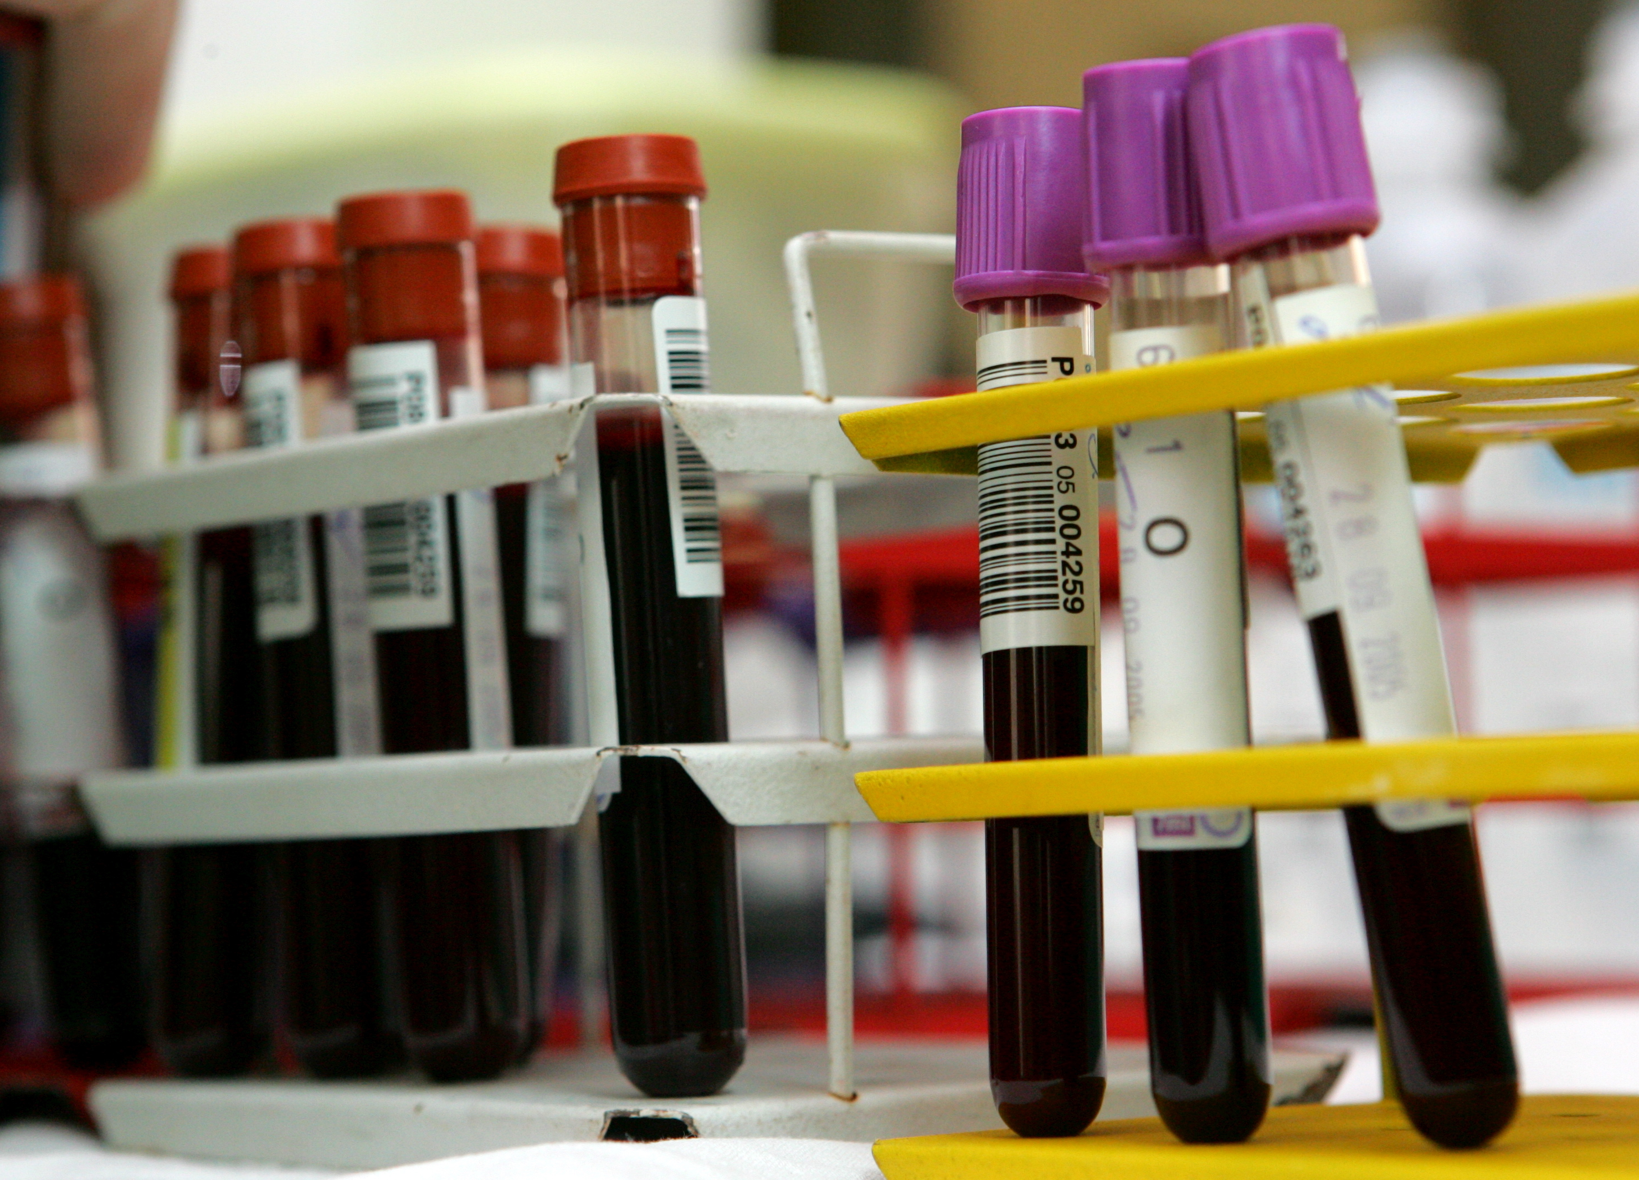
HIV and STI Testing for PrEP Initiation
Any patient requiring HIV/STI screening should be offered 3-site testing
3-site STI screening for chlamydia and gonorrhea¹
Swab oropharynx and rectum, and test urine
Genital testing with a swab is preferred for patients with a vagina, but urine is acceptable
Patients can self swab all sites
Gonorrhea/chlamydia often missed with urine/genital testing only
Venipuncture
HIV 1/2 Ag/Ab blood test²
Syphilis serology¹

Slide 31
Evidence for Oral PrEP

Slide 32
Efficacy of TDF/FTC for PrEP
MSM and
Transgender Women
Heterosexual
Men and Women
PWID
Reduction in HIV Incidence, TDF/FTC vs Placebo, %
Oral
TDF/
FTC
Oral
TDF/
FTC
Oral
TDF/
FTC
Oral
TDF/
FTC
Oral
TDF/
FTC
Oral
TDF/
FTC
iPrEx Trial¹ (N=2499)
Partners PrEP² (N=4758 couples)
Bangkok Tenofovir³ (N=2413)
Notes:
First—just to set the stage, we’ll acknowledge the well-established facts. PrEP works—according to this pivotal trial data from the original PREP regimen

Slide 33
PrEP Efficacy TAF/FTC vs TDF/FTC
DISCOVER Trial: HIV Incidence¹
Incidence Rate Ratio (95% CI)
HIV Incidence
FAVORS FTC/TAF
FAVORS FTC/TDF
0.34
NI
NI Margin
15 Infections
HIV Incidence Rate/100 PY
0.16
0.47
0.19
1.15
7 Infections
4386 PY
4370 PY
0
1
1.62
2
Daily TAF/FTC was statistically noninferior to daily TDF/FTC for HIV prevention, with TAF/FTC showing more favorable effects on BMD and biomarkers of renal safety.
Notes:
And more data that PrEP works
BMD, bone mineral density; eCrCl, estimated creatinine clearance; NI = noninferiority; PY, patient-years; TAF, tenofovir alafenamide; TGM, transgender man.
1. Mayer KH, et al. Lancet. 2020;396(10246):239-254; 2. https://www.accessdata.fda.gov/drugsatfda_docs/label/2020/021752s061lbl.pdf; 3. https://www.accessdata.fda.gov/drugsatfda_docs/label/2021/208215s019lbl.pdf; 4. Wood BR, Huhn GD. Open Forum Inf Dis. 2021;8(12):ofab542.

Slide 34
PrEP Efficacy Is Tied to Adherence
100
Partners PrEP⁵ Efficacy 75% Adherence 82%
80
PROUD⁶ Efficacy 86% Adherence ~100%
iPrEx³ Efficacy 44% Adherence 51%
60
Relative Reduction in HIV Incidence, %
TDF2⁴ Efficacy 62% Adherence 84%
40
20
VOICE/FEM-PrEP^{1,2} Efficacy 0%/6% Adherence 29%/≤37%
0
0
20
40
60
80
100
Medication Adherence Rate, %
Notes:
1. Marrazzo JM, et al. N Engl J Med. 2015;372(6):509-518; 2. Van Damme L, et al. N Engl J Med. 2012;367(5):411-422; 3. Grant RM, et al. N Engl J Med. 2010;363(27):2587-2599; 4. Thigpen MC, et al. N Engl J Med. 2012;367(5):423-434; 5. Baeten JM, et al. N Engl J Med. 2012;367(5):399-410; 6. McCormack S, et al. Lancet. 2016;387(10013):53-60.

Slide 35
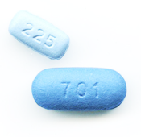
Emerging Data on TAF vs TDF Pharmacokinetics
Is TAF more “forgiving” of lower adherence rates of PrEP than TDF?
2 studies looked at drug concentrations in people at low risk of HIV who took oral PrEP pills either daily, twice in 3 days, or once in 3 days (ie, at 100%, 67%, and 33% of daily dosing)¹
Results¹:
TFV-DP levels were considerably higher in the TAF recipients
Levels of tenofovir in cells were 7 times higher when TAF was used than when TDF was used
Levels of TFV-DP were 2.6 times higher in TAF recipients taking only 1 pill every 3 days than in TDF recipients taking 1 pill every day
Implications for real-world application are not defined; however, a DISCOVERY post-hoc analysis found that HIV infection was more likely in people taking 2-4 TDF pills/week vs those taking 2-4 TAF pills/week.²
Notes:
This is one of those topics, as an example. Data are emerging on the benefits of TAF in PrEP—but are still evolving and clinicians will need to stay up to date.
ager JL, et al. AIDS. 2021;35(15):2481-2487
NOTES
Yager study: What this study does not show is that TAF has better efficacy than TDF when used as PrEP. This is an implication, but we have knowledge gaps about precisely how PrEP works. We do know from iPrEx that intracellular levels of tenofovir do predict PrEP efficacy. But iPrex only used TDF.
Spinner post-hoc analysis: A post-hoc analysis did find that HIV infection was more likely in people taking 2-4 TDF pills a week than in people taking 2-4 TAF pills per week.
This suggests that TAF could, in theory, be more ‘forgiving’ of relatively low rates of adherence to PrEP than TDF.

Slide 36
Prescribing Oral PrEP

Slide 37
Lab Testing and Monitoring for Oral PrEP
Test/Screen | Initiation | Every 3 Mo | Every 6 Mo | Every 12 Mo
HIV Assessment Signs/symptoms AHI Discuss whether continued need for PrEP; adherence, side effects, etc | X | X | X | X
HIV Status HIV-1/2 Ag/Ab test (lab preferred) HIV RNA assay | (HIV-1/2 Ag/Ab test only) | X | X | X
Renal Status eCrCl>60 mL/min/1.73 m² (TDF/FTC or TAF/FTC) eCrCl>30 mL/min/1.73 m² (TAF/FTC) If at baseline >50 yo OR eCrCl <90 mL/min/1.73 m² (TDF/FTC or TAF/FTC)ª | X |  | Xª | X
STI Screen (MSM/TGW)^{b} | X | X | X | X
STI Screen (heterosexually active men and women)^{b} | X |  | X | CT only
Lipid Screen (only for persons prescribed TAF/FTC) | X |  |  | X
Hepatitis Screens (HBV and HCV serologies; HAV serology for MSM or if at risk)^{1,2} | X | X (if not done at initiation)
Pregnancy Test (if of childbearing potential)² | X | X | X | X

Slide 38
Prescribing Oral PrEP
Once You’ve Taken the Following Steps
Identified patient at risk of HIV infection (or a patient expressed interest in starting PrEP)
Confirmed their interest and clinical eligibility
Patient weighs ≥35 kg
Obtained negative HIV test result
Confirmed no HIV exposure event within last 4 weeks
No sign/symptoms of AHI
Ordered necessary labs
You may initiate PrEP as long as there is a negative HIV test; you do not need to withhold PrEP until other tests are back
Prescription | Pill Supply | Return for Follow-up
Daily Oral PrEP | 1 fixed-dose combination tablet 90-day supply TDF/FTC OR 90-day supply TAF/FTC Not for those having receptive vaginal sex Optional: some clinicians prefer to give a 30-day supply at initiation to enable them to check on the patient sooner | Schedule follow-up visit for 30 or 90 days (depending on number of pills supplied)

Slide 39
Safety Considerations TDF/FTC & TAF/FTC Black Box Warnings^{1,2}
Risk of drug resistance with use of TDF/FTC or TAF/FTC for PrEP in patients with undiagnosed early HIV infection Use of TDF/FTC and TAF/FTC for PrEP is only for HIV-negative individuals
Posttreatment acute exacerbation of HBV infection Severe acute exacerbations of HBV have been reported in HBV-infected patients who have discontinued TDF/FTC, and may occur with TAF/FTC Hepatic function should be monitored closely in these patients
Notes:
Truvada = 6/2020
https://www.accessdata.fda.gov/drugsatfda_docs/label/2020/021752s061lbl.pdf
Descovy = 1/2022
https://www.gilead.com/-/media/55b14ac03ef94b6f98d5d3c31ea0137b.ashx

Slide 40
On-Demand PrEP With Oral TDF/FTC An Alternative to a Daily Pill
On-demand (also called event-driven or 2:1:1) dosing¹
Taken at specific time points only around times of anal intercourse
Recommendations are only for among MSM
Not for those having receptive vaginal sex or whose HIV risk is solely from IDU
Effective HIV prevention for MSM with infrequent sexual encounters and an alternative to daily TDF/FTC¹
Not FDA-approved, however, it is included in the CDC and other US and WHO guidelines^{1,2}
Some patients may use substances to enhance their sexual experiences (ie, chem sex) and use clean equipment; on-demand dosing is a viable option for these individuals
Sex
2 to 24 hours before sex
24 hours after first 2 pills
48 hours after first 2 pills

Slide 41
Evidence for CAB Long-Acting Injectable (LAI) PrEP

Slide 42
PrEP Efficacy CAB vs TDF/FTC
HPTN 083 Trial Results
Hazard Ratio (95% CI)
HIV Incidence
FAVORS CAB
FAVORS TDF/FTC
1.22
39 Infections
HIV Incidence Rate/100 PY
0.41
0.34ª
Superiority
Noninferiority
13 Infections
0.18
0.62
100 PY
100 PY
0
0.75
1.00
1.23
NI Margin
2.00
CAB was statistically superior to TDF/FTC in preventing HIV infection among MSM and TGW
Notes:
And newer data that even newer kinds of PrEP works

Slide 43
Prescribing CAB LAI

Slide 44
Lab Testing and Monitoring for CAB LAI
Test/Screen | Initiation | 1 Mo Visit | Every 2 Mo | Every 4 Mo | Every 6 Mo | Every 12 Mo | When Stopping CAB
HIV Assessment Signs/symptoms AHI Discuss whether continued need for PrEP; adherence, side effects, etc | X |  | X | X | X | X
HIV Status HIV-1/2 Ag/Ab test (lab preferred) HIV RNA assay | X | X | X | X | X | X | X
STI Screen (MSM/TGW)ª | X |  | X | X | CT only | GT/Syphilis only | X
STI Screen (heterosexually active men and women)ª | X |  |  |  | GT/Syphilis only | CT only
Pregnancy Test (if of childbearing potential)² | X | X | X | X | X | X

Slide 45
Prescribing CAB LAI
Once You’ve Taken the Following Steps
Identified patient at risk of HIV infection (or a patient expressed interest in starting PrEP)
Confirmed their interest and clinical eligibility
Patient weighs ≥35 kg
Obtained negative HIV test result
Confirmed no HIV exposure event within last 4 weeks
Patient not part of, or located in, high incidence population
No sign/symptoms AHI
Ordered necessary labs
You may initiate CAB LAI as long as there is a negative HIV test; you do not need to withhold PrEP until other tests are back
Prescription | With Oral Lead-In | Without Oral Lead-In
CAB LAI PrEP | At initiation provide Prescription for CAB daily oral lead-in for 4 weeks 1 month later (on the last day of the oral lead-in) CAB single 600 mg [3 mL injection, gluteal only] injection 1 month later CAB IM injection 2 months later and thereafter Provide CAB IM injection | At initiation provide CAB IM injection 1 month later CAB IM injection 2 months later and thereafter Provide CAB IM injection
Oral lead-in dosing may be used for 1 month prior to starting injections to determine tolerability for CAB.
Notes:
https://www.accessdata.fda.gov/drugsatfda_docs/label/2021/215499s000lbl.pdf
Apretude pI

Slide 46
Safety Considerations CAB LAI Warnings
Black Box Warning: Risk of drug resistance with use of CAB LAI (or oral CAB) for PrEP in patients with undiagnosed early HIV infection Use of CAB LAI for PrEP is only for HIV-negative individuals
Warnings/Precautions: hypersensitivity reactions have been reported in association with other integrase inhibitors, and hepatoxicity has been reported in patients receiving oral CAB; discontinue CAB LAI if either of these develop Depressive disorders have been reported with CAB LAI for PrEP; patients with depressive symptoms should be evaluated promptly
Notes:
Truvada = 6/2020
https://www.accessdata.fda.gov/drugsatfda_docs/label/2020/021752s061lbl.pdf
Descovy = 1/2022
https://www.gilead.com/-/media/55b14ac03ef94b6f98d5d3c31ea0137b.ashx

Slide 47
Monitoring and Follow-up Care

Slide 48
How Long Until PrEP Works? Time to Maximum HIV Protection (Tissue Concentration), by Mode of HIV Exposure
Tissue/Fluid | Approximate Time to Maximum Protection with Oral PrEP (days)¹ | Approximate Time to Maximum Protection with CAB LAI PrEP (days)²
Rectal tissue | 7 | 7
Rectal fluid |  | 7
Cervical tissue | 21 | 7
Cervical vaginal fluid |  | 7
Penile tissue | unknown | unknown
Injection drug use³ | 21 (Only TDF/FTC) | CAB LAI is not indicated for PWID

Slide 49
Counseling and Monitoring Topics
Medication-related
Common initial side effects include headache, abdominal pain, and weight loss with TDF/FTC, and diarrhea with TAF/FTC^{1,2}
May be taken with or without food^{1,2}
Daily adherence is important for effectiveness³
If planning to stop PrEP, continue PrEP for 28 days after last potential HIV exposure³
Common initial side effects include injection-site reactions and headache with CAB LAI⁴
Behavioral
PrEP does not prevent other STIs; other risk-reduction practices are still considerations for HIV, STI, and pregnancy prevention³
Avoiding sharing equipment for injection drug use will further reduce HIV risk³
Monitoring/Management³
The patient should be informed regarding clinic refill policies and procedures
PrEP is only for those who are HIV-negative; make sure the patient is clear about
Symptoms of acute HIV infection
The need for follow-up visits and lab tests
Notes:
CDC. USPHS. Preexposure Prophylaxis for the Prevention of HIV Infection in the United States—2021 Update. https://www.cdc.gov/hiv/pdf/risk/prep/cdc-hiv-prep-guidelines-2021.pdf. Accessed March 20, 2022; 2. https://www.accessdata.fda.gov/drugsatfda_docs/label/2020/021752s061lbl.pdf;
Truvada = 6/2020
https://www.accessdata.fda.gov/drugsatfda_docs/label/2020/021752s061lbl.pdf
Descovy = 1/2022
https://www.gilead.com/-/media/55b14ac03ef94b6f98d5d3c31ea0137b.ashx
Drugs@FDA. www.accessdata.fda.gov/scripts/cder/daf. Accessed August 22, 2022

Slide 50
For Patients Who Miss a Dose of CAB
Patients missing a dose, or planning to miss a scheduled monthly injection visit should be informed the following:
Oral dosing may be used to replace up to 2 consecutive monthly injections
If patients are more than 4 weeks late for their injections, counsel them to determine if an ongoing risk of HIV exposure is anticipated; if so
"Reload” with a 4-week interval between the next 2 injections and then return to 8-week intervals
Or discuss with them the need for daily oral PrEP or other effective HIV prevention methods

Slide 51
The CAB “Tail”
CAB has a long “tail” of gradually declining drug levels when discontinuing the injections¹
During this “tail” phase, it's possible CAB levels will fall below a protective threshold
Should this persist, a patient is at risk of HIV acquisition¹
Median time to undetectable CAB plasma levels (in the HPTN 077 trial)¹
44 weeks for men
67 weeks for women
With a wide range regardless of gender
While there is a risk of developing a drug-resistant strain if HIV infection is acquired during the “tail”, this has not been borne out in studies conducted during the tail-phase^{1,2}
Notes:
1. Highleyman L. NAM AIDSMAP. 2021. https://www.aidsmap.com/news/dec-2021/us-approves-injectable-cabotegravir-prep. Accessed April 8, 2022; 2. CDC. USPHS. Preexposure Prophylaxis for the Prevention of HIV Infection in the United States—2021 Update. https://www.cdc.gov/hiv/pdf/risk/prep/cdc-hiv-prep-guidelines-2021.pdf. Accessed March 20, 2022; 3. https://www.accessdata.fda.gov/drugsatfda_docs/label/2021/215499s000lbl.pdf; 4. Personal communication with Dr. Raphael Landovitz. April 28, 2022.

Slide 52
For Patients Who Wish to Discontinue CAB
Because of the “tail,” remind patients to see their clinicians before discontinuing CAB for PrEP¹
Dr. Raphael Landovitz, clinical investigator in the CAB LAI trials, recommends the following²
For someone discontinuing injectable PrEP who remains at-risk for HIV infection, an individualized discussion is appropriate about how to provide ongoing HIV prevention
This may include oral PrEP options in combination with other effective HIV prevention behavioral changes
The US FDA recommends quarterly HIV RNA testing over 1 year after the last injection^{1,2}
Notes:
1. Highleyman L. NAM AIDSMAP. 2021. https://www.aidsmap.com/news/dec-2021/us-approves-injectable-cabotegravir-prep. Accessed April 8, 2022; 2. CDC. USPHS. Preexposure Prophylaxis for the Prevention of HIV Infection in the United States—2021 Update. https://www.cdc.gov/hiv/pdf/risk/prep/cdc-hiv-prep-guidelines-2021.pdf. Accessed March 20, 2022; 3. https://www.accessdata.fda.gov/drugsatfda_docs/label/2021/215499s000lbl.pdf; 4. Personal communication with Dr. Raphael Landovitz. April 28, 2022.

Slide 53
Emerging PrEP for HIV Prevention

Slide 54
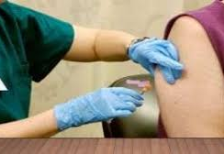
Clinical Trials Underway for Lenacapavir Long-Acting SQ Injectable And TAF/FTC for Cisgender Women
Lenacapavir¹
Long-acting HIV capsid inhibitor
SQ injectable every 6 months
2 phase 3 randomized controlled trials to
Assess efficacy and safety of lenacapavir for PrEP, and TAF/FTC for PrEP²
LEN and TAF/FTC are separate study arms among cisgender adolescent and young women (16 to 25 years of age) at high risk of HIV-1 acquisition
Assess effectiveness and safety of lenacapavir for PrEP³
Among MSM, TGW, TGM, and gender-nonbinary people ≥16 years of age who have condomless receptive anal intercourse
Notes:
And we anticipate even MORE evolving data that even newer PreP with improved administration and dosing intervals will WORK!
Gilead Announces New Arm of HIV Women’s Prevention Study to Evaluate the Investigational Long-Acting HIV-1 Capsid Inhibitor Lenacapavir in Addition to Descovy for PrEP®
Foster City, Calif., December 21, 2020 – Gilead recently announced the addition of a new study arm to the Women’s HIV Prevention Study evaluating the use of lenacapavir, the company’s investigational, long-acting HIV-1 capsid inhibitor, as an injectable PrEP option administered every six months. The planned trial in adolescent girls and young women will also evaluate the use of oral HIV prevention options Descovy (emtricitabine 200 mg/tenofovir alafenamide 25 mg) for PrEP® and Truvada (emtricitabine 200 mg and tenofovir disoproxil fumarate 300 mg tablets; F/TDF) for PrEP®.
WOMEN’S STUDY ARMS:
LEN + PLACEBO TAF/FTC
LEN + PLACEBO TDF/FTC
PLACEBO LEN + TAF/FTC
PLACEBO LEN + TDF/FTC

Slide 55
2 New Studies Show Potential for Self-administration of High-Concentration CAB LAI
Study injecting CAB + rilpivirine (currently used for HIV treatment) into thigh muscle resulted in pharmacokinetic profile and tolerability similar to that of standard buttocks injections¹
Another study found that a higher-concentration CAB LAI resulted in drug levels and safety profile similar to those of the current medication²
These studies offer a look into the potential for self-administration of CAB LAI PrEP^{1,2}
Notes:
Han = cab + rip

Slide 56
Developing Personalized PrEP Strategies

Slide 57
Individualizing Care PrEP Selection
Oral PrEP Advantages¹
LAI Advantages^{2,3}
Customizing Oral Tx³⁻⁶
Flexibility of starting/stopping, or switching to 2:1:1 (MSM only) depending on HIV risk
Easily accessible
Long-term experience with oral PrEP medications
Easy to incorporate pill-taking into the daily routine
No staff involved in administration
Eliminates burden of daily pill-taking
Potential increase in patient adherence
Privacy: no one need to know you’re taking PrEP
Potential ease of administration with future SQ options
Renal: eCrCl <60 mL/min/ 1.73 m²: CONSIDER TAF/FTC
BMD concerns/young person still growing: CONSIDER TAF/FTC
Lipid concerns: CONSIDER TDF/FTC
Body weight concerns: CONSIDER TDF/FTC
Person with a vagina: TDF/FTC
On-demand flexibility: TDF/FTC
Notes:
1. Cooper RL, et al. Inquiry. 2021;58:469580211017666; 2. Bunting SR, et al. Sex Transm Dis. 2020;47(8):530-534; 3. Zhang C, et al. BMC Nursing. 2020;19(1):117; 4. Evans C. BMJ Open. 2020;10(5):e036192; 5. Xue Y, et al. JAMA. 2019;321(1):102-105; 6. Grumbach K, et al. Ann Fam Med. 2003;1(2):97-104.

Slide 58
Comparing PrEP Options
Consider for | TDF/FTC | TAF/FTC | CAB LAI
Renal Function¹⁻⁴ |  | ✓ | ✓
Bone Mineral Density^{1,3,4,5} |  | ✓ | ✓
Lipids⁴⁻⁷ | ✓
Gender-Affirming Hormones⁴ | ✓ | ✓ | ✓
Other Considerations
Side Effects⁴ | Diarrhea (6%); nausea (5%) | Diarrhea (5%); nausea (4%) | Injection-site reaction (32%-81%); mostly mild and greatest initially
Approved to Prevent HIV From IDU⁵ | ✓
Receptive Vaginal Sex⁵ | ✓ |  | ✓
On-Demand Use⁵ | ✓
Frequency of Dose⁵ | 1 pill daily | 1 pill daily | Injection in buttocks every 2 months
Notes:
Apretude = CAB, cabotegravir; Descovy = TAF/FTC, tenofovir alafenamide/emtricitabine; TFV-DP, tenofovir diphosphate; Truvada = TDF/FTC, tenofovir disoproxil fumarate/emtricitabine.
1. https://www.accessdata.fda.gov/drugsatfda_docs/label/2020/021752s061lbl.pdf; 2. Gandhi M, et al. Lancet HIV. 2016;3(11):e521-e5283; 3. https://www.accessdata.fda.gov/drugsatfda_docs/label/2021/208215s019lbl.pdf; 4. NYSDOH AIDS Institute. Clinical guidelines program. 2022. https://www.hivguidelines.org/home/guideline-slides-and-pocket-guides/. Accessed July 13, 2022. 5. CDC. USPHS. Preexposure Prophylaxis for the Prevention of HIV Infection in the United States—2021 Update. https://www.cdc.gov/hiv/pdf/risk/prep/cdc-hiv-prep-guidelines-2021.pdf. Accessed March 20, 2022; 6. Shah S, et al. AIDS. 2021;35(suppl 2):S189-S195; 7. Wood BR, Huhn GD. Open Forum Inf Dis. 2021;8(12):ofab542.

Slide 59
History of PrEP Cost and Access
June 2019: PrEP receives an “A” rating by the USPSTF¹
January 2021: the Affordable Care Act requires nearly every private health insurers to cover any USPSTF item with an “A” or “B” rating without cost-sharing²
July 2021: Due to payer noncompliance, the government releases guidance to insurers, reminding them of their obligation to cover PrEP²
The Public Health Service Act includes services to prevent the acquisition of HIV, such as prescriptions, clinic visits, labs, and immunizations
Insurers are required to cover PrEP services to prevent HIV acquisition.²
Notes:
USPSTF, US Preventive Services Task Force.
1. US Preventive Services Task Force. Preexposure Prophylaxis for the Prevention of HIV Infection: USPSTF Recommendation Statement. JAMA. 2019;321(22):2203-2213. 2. US Department of Health and Human Services. Guidance Portal. FAQs about Affordable Care Act Implementation Part 47. https://www.hhs.gov/guidance/document/faqs-about-affordable-care-act-implementation-part-47. Accessed August 31, 2022.

Slide 60
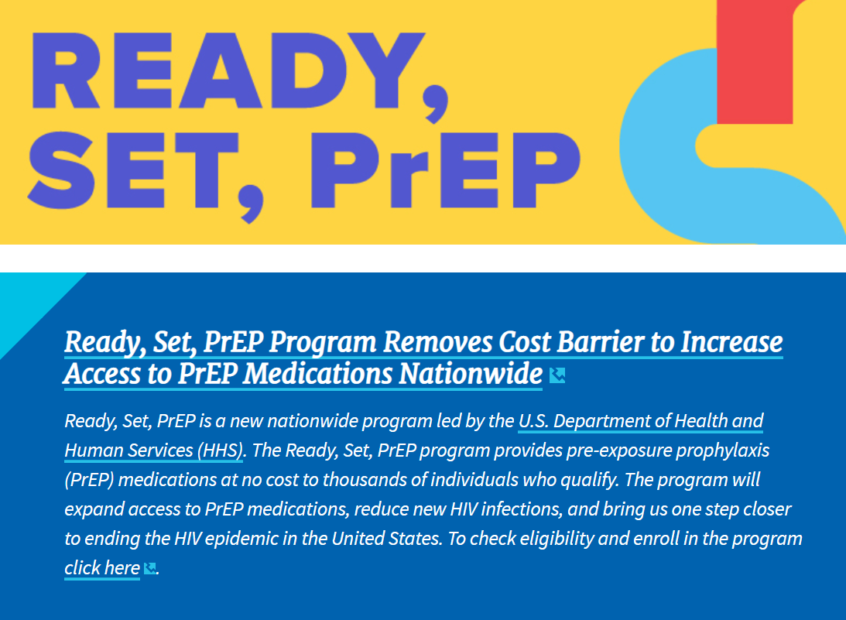
Ready, Set, PrEP!
What is it?
Ready, Set, PrEP provides free PrEP HIV-prevention medication
Clinic visits and lab tests vary depending on income
If PrEP medication is a good option for your clients, they can choose the application process that is most convenient
GetYourPrEP.com
By phone: 855-447-8410
In person at a health care provider’s office, including a community health center where trained staff can assist
Patients can receive PrEP medication through a pharmacy of their choice
Clients can apply for this program if they
Don’t have health insurance coverage for prescription drugs
Have taken an HIV test and received a negative result before starting the program
Have a prescription for PrEP
Live in the US, including tribal lands or territories

Slide 61
PrEP Access, Assistance, and Information
Patient and Provider assistance: PleasePrEPMe.org
https://pleaseprepme.org/
Information about PrEP, nPEP, insurance and insurance rights, finding a PrEP/nPEP provider, and a list of PrEP resources by state
Provider assistance: AETC; AIDS Education & Training Center Program: National Coordinating Resource Center
Supports national HIV priorities by providing training, consultation, and resources
https://aidsetc.org/
Patient assistance (without insurance)
The PrEP patient assistance program will provide medication at no cost for those who meet income guidelines
https://www.gilead.com/purpose/medication-access/us-patient-access
Uninsured 24/7 support online, by phone during business hours and fax enrollment:
https://www.gileadadvancingaccess.com/financial-support/uninsured
Copay assistance (for patients with nongovernment insurance)
https://www.gileadadvancingaccess.com/copay-coupon-card
Phone number: 1-877-505-6986
Copay assistance/out-of-pocket costs
ViiV Connect https://www.viivconnect.com/for-providers/viivconnect-programs/
Visit our Clinical Resource Center for additional information about PrEP
www.ExchangeCME.com/PrEPpcpResources

